Slide 1

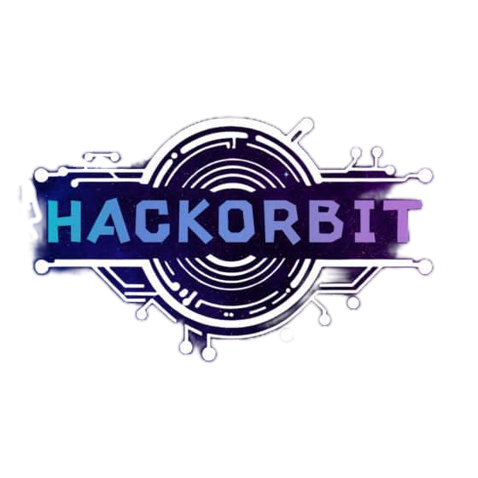



HackOrbit 2025
NeuroNovas

Slide 2

Health Monitoring
Mental health conditions like depression and anxiety often go undetected due to stigma and limited access to care. There is a need for a non-invasive, AI-powered health monitoring solution that can analyse users’ language in real-time to identify early signs of mental distress and enable timely intervention.

Slide 3
PROPOSED SOLUTION
“Feel heard. Feel safe. Feel batter – with Psybot.”
We purposed an AI-powered mental health monitoring tool that uses Natural Language Processing to detect signs of depression, anxiety and stress from users written or spoken conversations.
Continuously monitors users-interactions to identify emotional cues in real-time.
Understands tone, word patterns and conversational context to detect stress, sadness or anxiety.
Calculates a dynamic ‘mental wellness score’ based on ongoing interactions and sentiment trends over time.
Considers time and frequency of user-interactions to access behavioral patterns(e.g. late-night chats, response delays)
Balances AI analysis with optional human therapist intervention for deeper support.
Built with advanced NLP models, sentiment scoring algorithms and privacy-first architecture to ensure trust and safety .

Slide 4
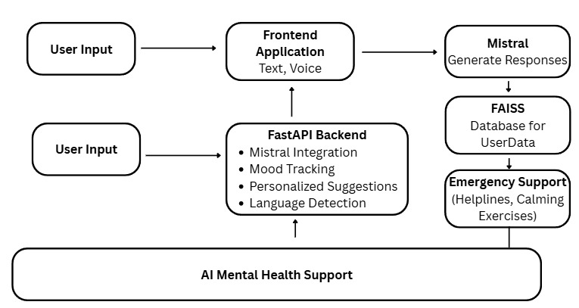
FLOWCHART

Slide 5
FLOWCHART (Explanation)
🧠 Psybot – AI Mental Health Support System
Psybot is an AI-powered mental health companion designed to offer empathetic, multilingual support through both text and voice interactions.
The system captures user input via a web interface and processes it through a FastAPI backend integrated with the Mistral language model for generating calming, context-aware responses.
User mood is tracked in real-time using sentiment analysis, and personalized suggestions like motivational quotes, videos, and breathing exercises are offered accordingly.
To enhance safety, Psybot uses a FAISS vector database to store emotional context and trigger alerts.
If distress crosses a defined threshold, emergency contacts are notified or mental health helplines are suggested.
Goal: To deliver real-time, responsive, and personalized mental wellness support — accessible to all, anytime, in multiple languages.

Slide 6
FEATURES AND NOVELTY
Features:
Multimodal input (Text and Voice) - Supports both typed and spoken conversations using integrated speech-to-text recognition.
24/7 Conversational Monitoring – Always available AI assistant that listens you any time , offering a emotional and non-judgmental space for expressing yourself.
Real-Time Emotion and Sentiment Analysis – Detects emotions like stress, sadness or anxiety from both textual and vocal cues using NLP and tone analysis.
Time and Behavior based pattern analysis – Monitors interaction timing ( e.g Late-night usage) to detect irregular or high-risk behavior patterns.
Crisis Detection and Emergency Escalation – Triggers alerts to emergency contacts or mental health professionals if the user’s wellness score indicates severe risk.
Security and Privacy – Ensures encrypted, anonymized data handling with user consent.

Slide 7
Novelty:
Human Centric Insights Through Typing Behavior
Analyzes typing patterns
Long clauses can be signs of possible sadness .
Rapid all-caps typing can be signs of potential anger, to detect subtle emotional states, adding a human touch to deep tech.
Emotional Clues from Clock-Time
Track the time of user interactions with patterns like frequent late-night chats potentially indicating emotional distress or insomnia.

Slide 8
DRAWBACK AND SHOWSTOPPERS
Drawbacks:
While the system can flag emotional distress, it is designed to support, not replace licensed mental health professionals. Human intervention is recommended when high-risk signs are detected.
User data is handled with encryption and constant protocols. While no digital system is 100% immune, we are committed to minimizing any risk with ongoing security upgrades.
Current system does not fully support visually impaired users, but inclusive design and accessibility features are part of our roadmap.
Right now the system gives general emotional feedback. We plan to make it more personalized so it can detect stress and anxiety earlier.
Showstoppers:
Crisis Detection and Life Saving Response System
When a user’s mental health score crosses a critical threshold, our system activates Crisis Mode, detecting signs of deep emotional distress(eg.. Suicidal thoughts or severe hopelessness).
Real – Time emotion crisis detection
Two – Level safety trigger:
Level 1 – Asks user if they seek help and offers support options.
Level 2 – If risk is extreme, provides emergency contacts immediately (even without consent), prioritizing safety.
Provides instant access to motivational videos, breathing exercises, guided meditations and emotional support quotes

Slide 9
NeuroNovas
Team Details
Kulwinder Singh – Frontend Developer (Email Id: khurmikaran1@gmail.com) Responsible for building the user interface and integrating features like text, voice, and video input for a smooth user experience.
Tarinee – Backend Developer + Team Leader (Email Id: tarinee20005@gmail.com) Handles backend development using FastAPI, including API creation, GPT integration, mood tracking, and database operations.
Millee Mittal – Research & Development + Project Lead (Email Id: millee.mittal@s.amity.edu) Leads R&D for emotional AI, multilingual capabilities, and emergency response logic. Also manages timelines and coordinates the entire project.
Vanshika Sambher – Research & Development (Email Id: vanshikasambher@gmail.com) Focused on emotion detection technologies, cultural sensitivity analysis, and optimizing chatbot responses.
Contact Number: Tarinee- 62842 00551 Kulwinder Singh- 98771 98210

Slide 10
Thank you

